Slide 1
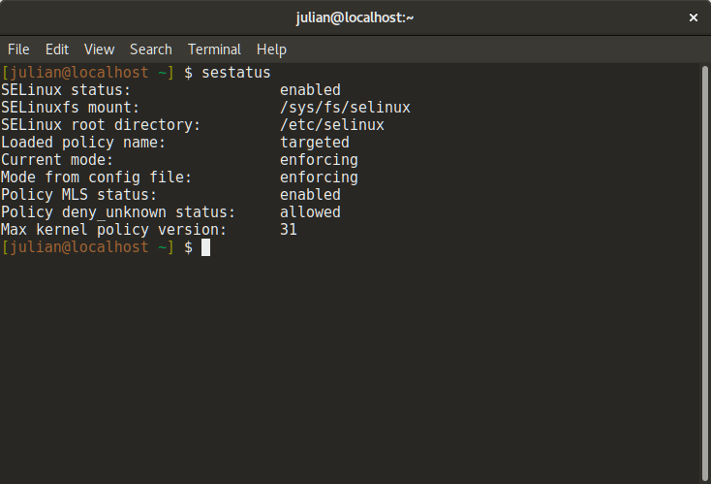
Secure Enhanced Linux
Julian Richen

Slide 2
SELinux?
Started as a research project from the National Security Agency (NSA)
A set of patches using the Linux Security Modules (LSM)
Hardening GNU/Linux systems with extra security policies and enforcing Mandatory Access Control (MAC)
Similar to modules like AppArmor, Smack, TOMOYO
NSA published the code under the GPL in 2000
Upstream Linux kernel adopted patches in 2003

Slide 3
Who develops it?
NSA
Red Hat
MITRE Corporation
Secure Computing Corporation (SSC)
Individual contributors & companies
CUPS Project, SAMBA Project, IBM, Tresys Technology, and more
Full list:
https://www.nsa.gov/what-we-do/research/selinux/contributors.shtml

Slide 4
Source?
Source:
https://github.com/SELinuxProject/selinux
Bugs
NSA: selinux@tycho.nsa.gov
Red Hat: https://bugzilla.redhat.com/
Policies
https://github.com/TresysTechnology/refpolicy

Slide 5
Who uses it?
Linux Distros
RHEL, Fedora, SuSE, CentOS, Debian, Ubuntu
United States Government
NSA, DoD, etc…
Enterprise
Data sensitive companies, healthcare, or anyone really
Android
Google implemented SELinux in Android 4.3 (2015)

Slide 6
What does it solve?
Implements Mandatory Access Control (MAC)
Focus on process context instead of role-based security (think DAC)
Enhances Discretionary Access Control (DAC); aka Ownership (user, group, other) with read/write/exec permissions
MAC policies can be set for:
Users
Files
Directories
Memory
Sockets
tcp/udp ports
And more!

Slide 7
Discretionary Access Controls
Access to objects is restricted based on the identity of a subject and/or group (ownership + permissions).
Controls are “discretionary” because subjects have a level of permissions that allow them to reach a subject.

Slide 8
Discretionary Access Controls
User |  |  | Group |  |  | Other
r | w | x | r | w | x | r | w | x

Slide 9
Mandatory Access Control
Operating Systems constrain the ability of the subject to access or perform operation on an object or target.
Basically, access to objects is restricted based on the security levels set by the security context.

Slide 10
How does SELinux work?
It’s basically Mandatory Access Control
SELinux doesn’t replace DAC, MAC can work alongside DAC
SELinux can be enabled/disabled at anytime and system will fallback to DAC
SELinux uses “Labels” for MAC
These labels are then followed with “Type Enforcement”
SELinux needs extended attributes on file-system to work
Labels are added as extended attributes
Use or make security policies
Security policies are just pre-made lists of labels for lots of packages on a GNU/Linux system
SELinux ships with targeted, minimum and mls as defaults.

Slide 11
Labeling & Type Enforcement
Labeling
Every object (file, process, port, etc..) has a SELinux context/label
Label’s job is to create logical groups/levels which the object may interact with
Format
user:role:type:level(optional)
Labels should be logical, e.g a http servers & ports 80/443 should be grouped together because a http will use those ports
Type Enforcement
The part of the policy that says a subject with “abc label” can interact with an object with “xyz label”.

Slide 12
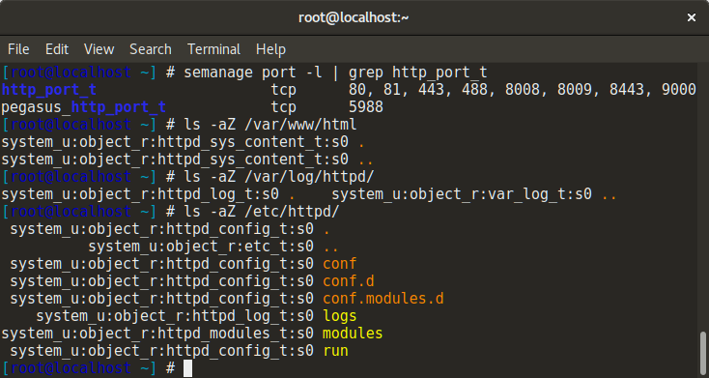
Label & Type Enforcement Example
It makes sense that httpd_* labeled objects should interact together.
It doesn’t make sense for httpd labeled content to access sensitive files like /etc/shadow or files in the home directory.
Object | label
httpd process | httpd
/usr/bin/httpd | httpd_exec_t
/etc/httpd/ | httpd_config_t
/var/log/httpd/ | httpd_log_t
/var/www/html/ | httpd_sys_content_t
Port 80 & 443 | httpd_port_t
/etc/shadow | shadow_t
/home/<user>/* | user_home_t

Slide 13
SELinux Policies
Policy
Enforcing
Enforce all policies.
Permissive
Prints warnings instead of enforcing.
Disabled
No policy is loaded.
Types
Targeted
Support a greater number of confined daemons, can confine other users and areas. Good confinement for most use-cases.
Minimum
Support minimal set of confined daemons, rest are set as unconfined_t. Used for users to test SELinux and devices that only need to confine a few daemons.
MLS
Multi Level Security protection, lots of confined daemons and users. Used in high-security environments (think Government).
Write your own
You can write policies that fit your machine, business, etc…

Slide 14
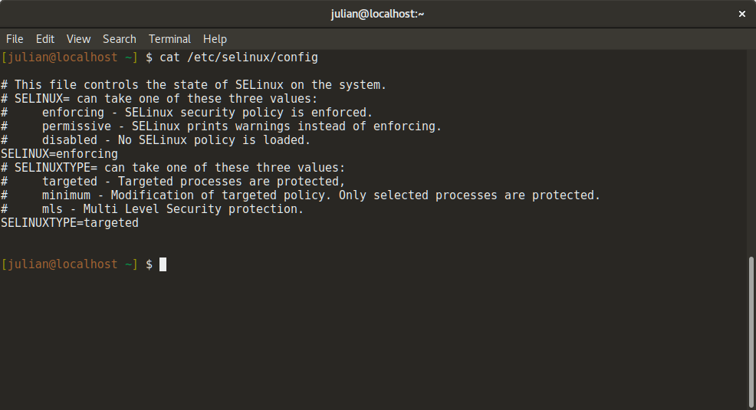
cat /etc/selinux/config

Slide 15
Attributions
Docs on SELinux source
https://github.com/SELinuxProject/selinux
Red Hat’s Thomas Cameron yearly SELinux presentation:
http://people.redhat.com/tcameron/Summit2017/SElinux/selinux_for_mere_mortals_2017.pdf
Fedora docs
https://docs-old.fedoraproject.org/en-US/Fedora/25/html/SELinux_Users_and_Administrators_Guide/index.html
SELinux intro by Digital Ocean
https://www.digitalocean.com/community/tutorials/an-introduction-to-selinux-on-centos-7-part-1-basic-concepts

